Slide 1
Weak Supervision and Active Learning
MPHY0050 – Applied AI for Medical Imaging
21 Jan 2026 - Session 4
Tianqi Yang
Research Fellow
UCL Hawkes Institute, Computer Science, University College London, UK

Slide 2
Previous Sessions
● The Crucial Role of Data in ML and DL
● Limited Data and Overcoming Solutions
● Knowledge Distillation
● Transfer Learning
● Data Augmentation
● Data Synthesis

Slide 3
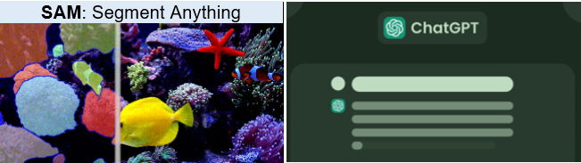
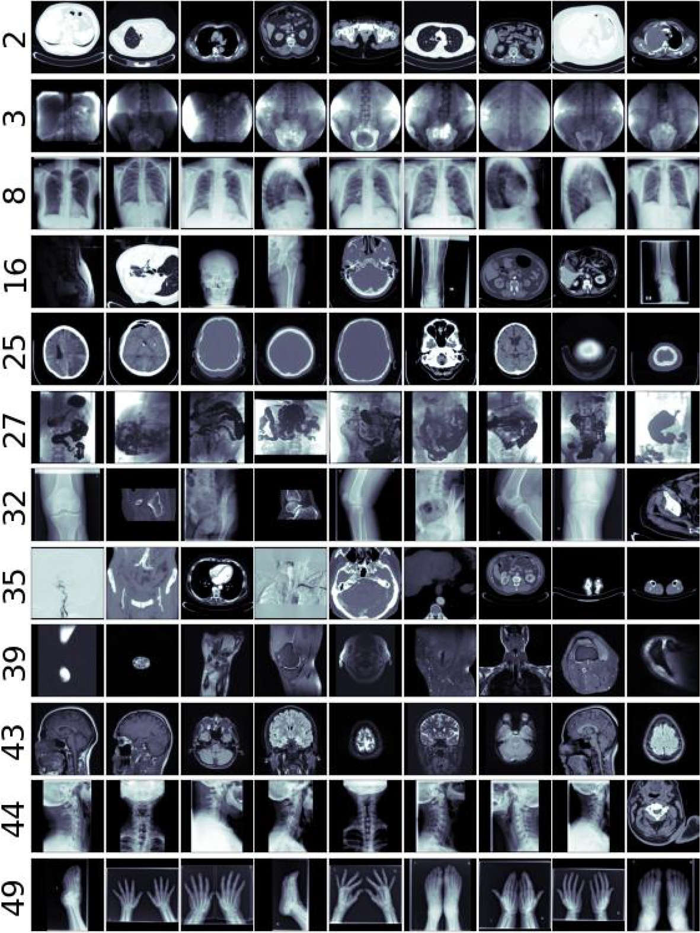
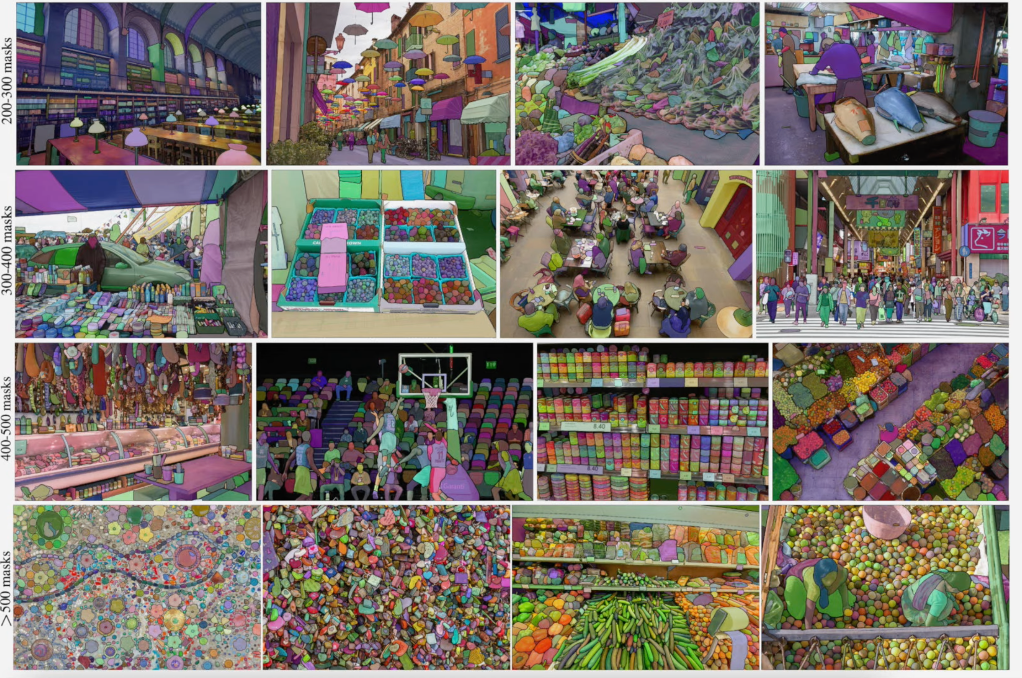
Motivation
Foundation Models
Medical Imaging
Trained on Massive Quantity of Data
SAM: 1B image data

Slide 4
Motivation
Medical Imaging
Is it easy to annotate or label the medical images?
Time consuming
Complexity & dimensionality
Ethical, legal, privacy constraints
Inter-observer variability
Expert dependence
Major Challenges
Can we train a deep networking without needing tons of labels?

Slide 5
Learning Objectives
● Weak Supervision
● Active Learning
● Active Learning Types: Uncertainty, Density, Diversity
● Hands-on Practical on Uncertainty Sampling
● Hands-on Practical on Density & Diversity Sampling
● Active Learning Strategies
● Active Learning Tools for Medical Tasks

Slide 6
Weak Supervision
Weak Supervision, a branch of ML and DL, addresses the challenges of acquiring labeled data for training when:
● The existing labeled data is insuﬃcient for achieving good model performance.
● The available labeled data is noisy or originates from an imprecise source.
● There is a shortage of domain experts, or acquiring their expertise is prohibitively costly.
● There is limited time for manual annotation.

Slide 7
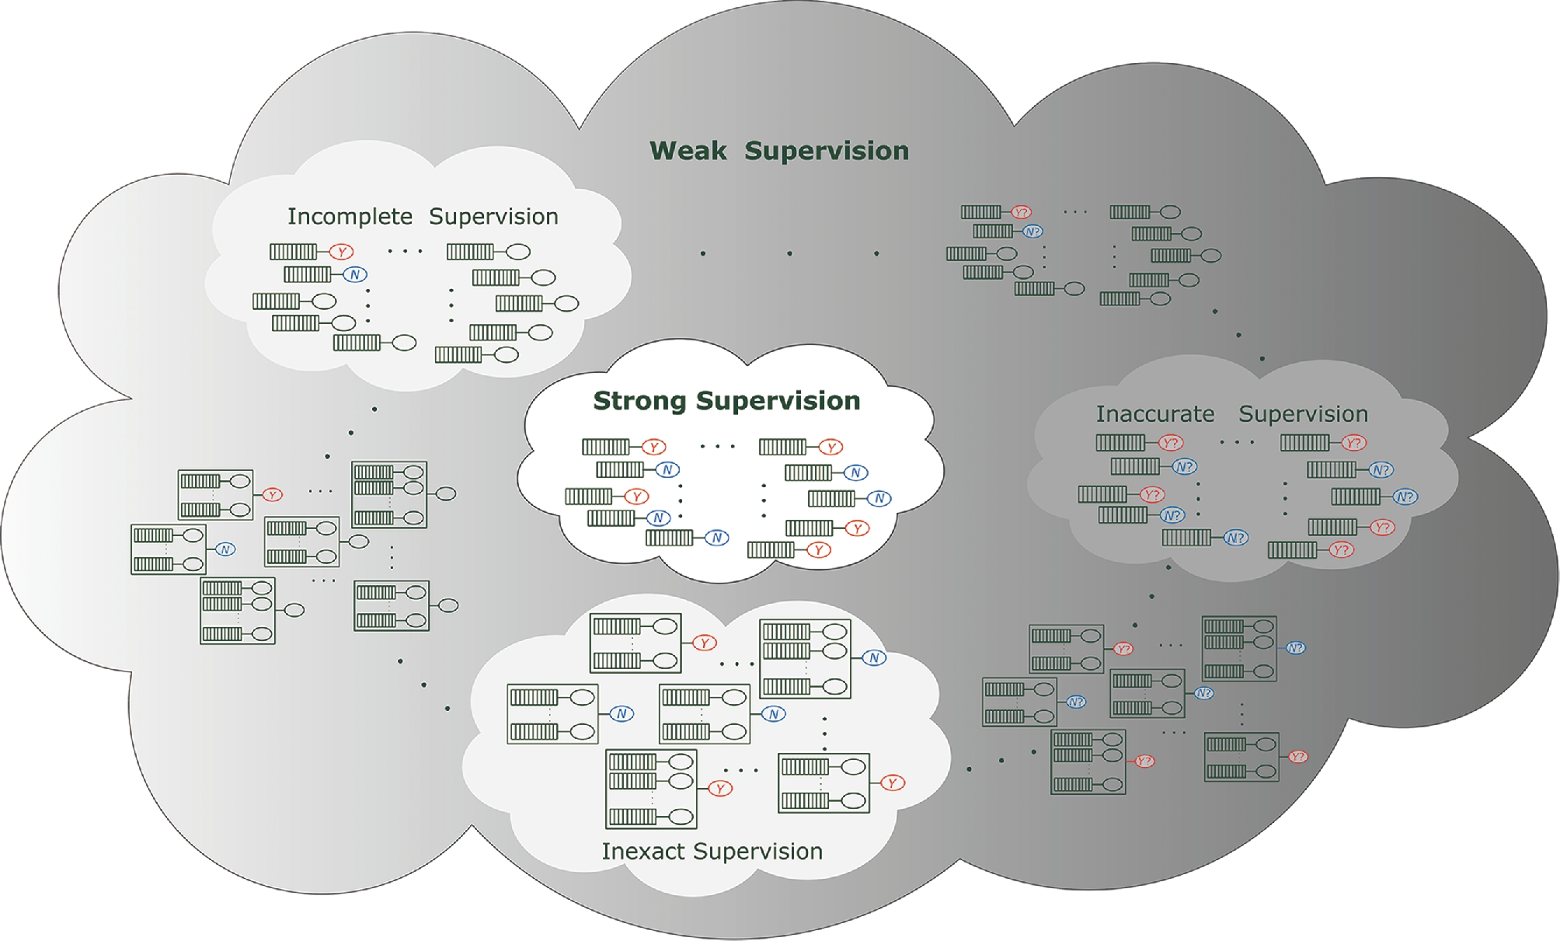
Weak Supervision Types
The most common situation where a small subset of training data is labelled while the other is not
A situation where the labels contain errors, as is often the case with crowdsourcing
A situation where the labels are there but not providing the exact information the problem needs
Natl Sci Rev, Volume 5, Issue 1, January 2018, Pages 44–53, https://doi.org/10.1093/nsr/nwx106

Slide 8
Weak Supervision Types
Incomplete Supervision
Inexact
Supervision
Inaccurate
Supervision
w/o human intervention
with human intervention
Semi-Supervised
Learning
Active
Learning
Multi-Instance
Learning
Data Engineering

Slide 9
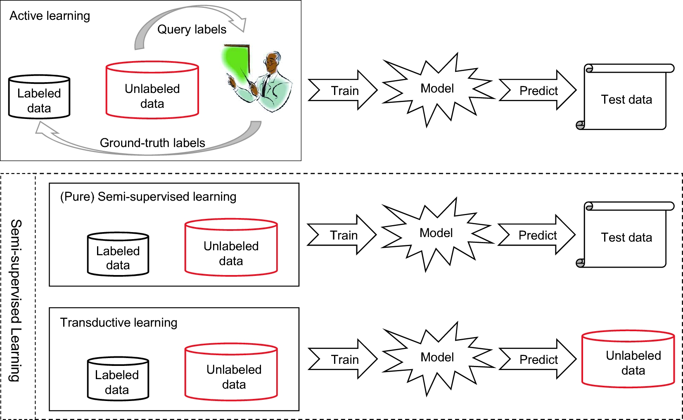
Incomplete Supervision
(unseen)
Natl Sci Rev, Volume 5, Issue 1, January 2018, Pages 44–53, https://doi.org/10.1093/nsr/nwx106

Slide 10
Incomplete Supervision
Active
Learning
Involve humans in strategically selecting additional labeled data. It focuses on unlabelled data points expected to provide the most informative insights to the model resulting new labels enhance the model's performance.
Semi-supervised
Learning
Trains models using a small amount of labeled data and a large amount of unlabeled data, reducing the need for extensive manual annotation while leveraging abundant raw data to understand overall patterns and structures.

Slide 11
Active Learning Strategies
Active
Learning
Uncertainty Sampling
Label data points where the current model is least certain
Density sampling
Label data points that are representative of many other points
Diversity sampling
Label data points that are least like already labeled points

Slide 12
Active Learning Strategies
Uncertainty Sampling
Labelled
Training
Testing
High Uncertainty
Labelling
Unlabelled
Low Uncertainty
Model
Data
Prediction

Slide 13
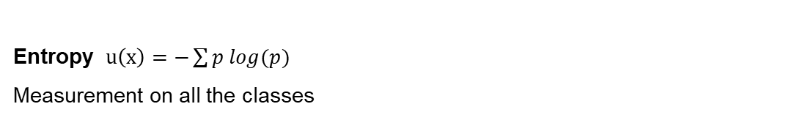
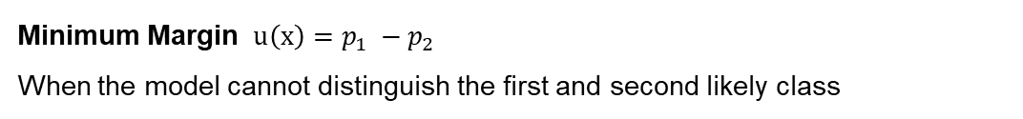
Active Learning Strategies
Uncertainty Sampling
Classification - Let predicted probabilities be $p=(y|x)$
Least Confidence $u\left(x\right)=1−max(p)$
Minimum Margin $u\left(x\right)=p_{1} −p_{2}$
When the model cannot distinguish the first and second likely class
Measure Uncertainty
Entropy $u\left(x\right)=−\sum{p log(p)}$
Measurement on all the classes

Slide 14
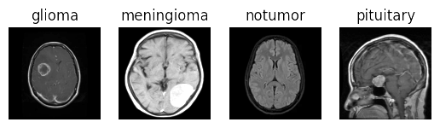
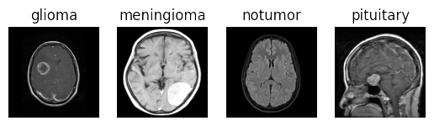
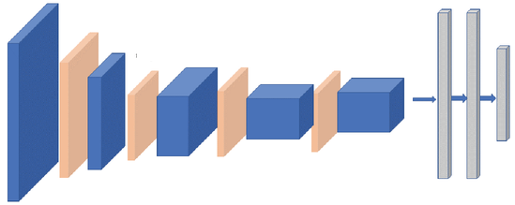
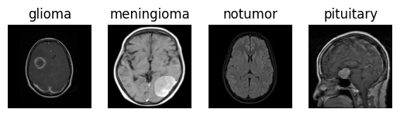
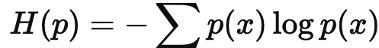
Active Learning Strategies
Uncertainty Sampling
Tumor
Notumor
Probability
0.5
0.5
Tumor
Notumor
Uncertainty = 1
Entropy based Uncertainty,
Sample | Probability |  | Uncertainty
 | Tumor | Notumor
1 | 0.5 | 0.5 | 1
2 | 0.999 | 0.001 | 0.01
3 | 0.8 | 0.2 | 0.15
4 | 0.6 | 0.4 | 0.97

Slide 15
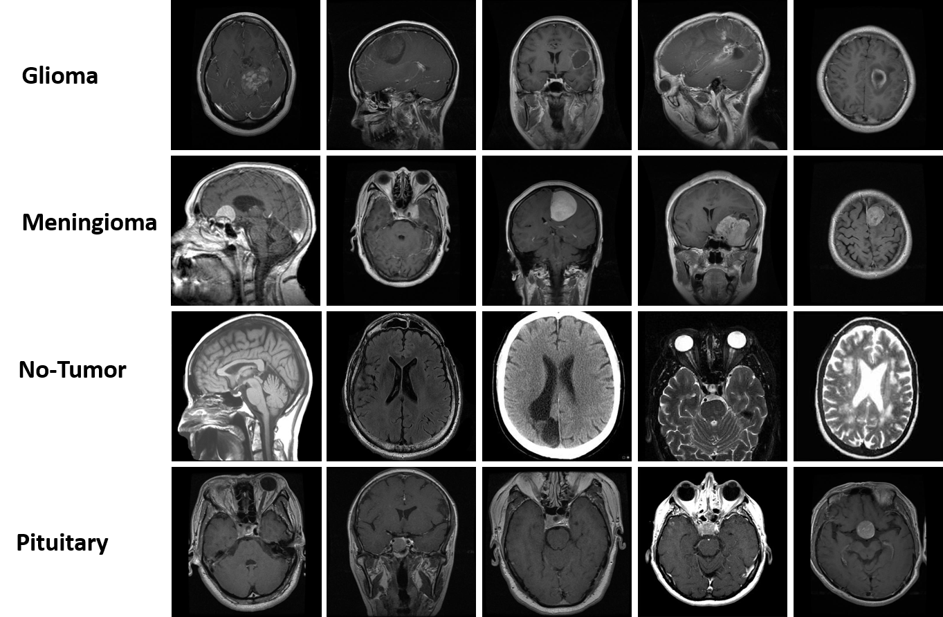
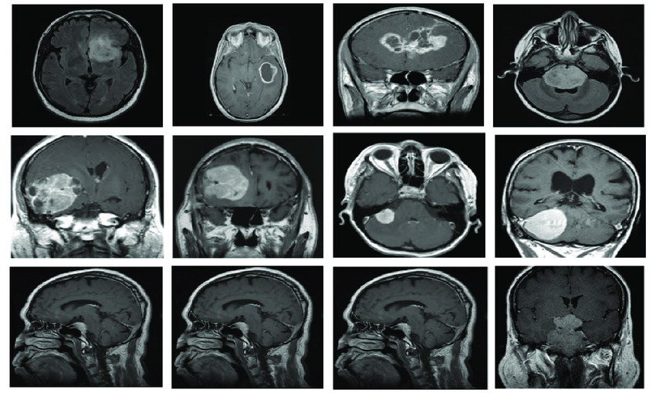
Active Learning Strategies
Uncertainty Sampling
Brain Tumor Classification Dataset
Total samples: 5712
Training samples: 4569
Validation samples: 1143
Mapping of class: {0: 'glioma', 1: 'meningioma', 2: 'notumor', 3: 'pituitary'}
Labelled Dataset
Unlabelled Dataset

Slide 16
Active Learning Strategies
Uncertainty Sampling
Brain Tumor Classification Dataset
Total samples: 5712
Training samples: 4569
Validation samples: 1143
Mapping of class: {0: 'glioma', 1: 'meningioma', 2: 'notumor', 3: 'pituitary'}
Labelled
Dataset
Validation Accuracy: 96.4%
List of Uncertainty for each sample
Unlabelled
Dataset

Slide 17
Active Learning Strategies
Uncertainty Sampling
Labelling
Labelled
Dataset
Sample-1: n% of high uncertainty
Train
Remaining with lower uncertainty
Unlabelled
Dataset
Inference
Before: Validation Accuracy = 96.4%
After: Validation Accuracy = 98.9%

Slide 18
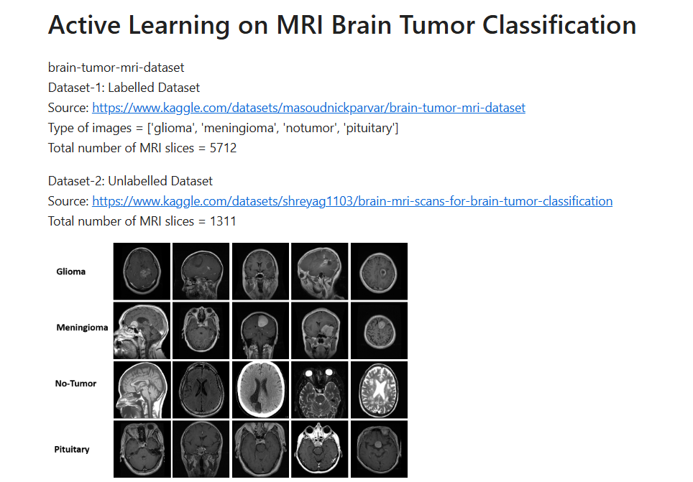
Active Learning Strategies
Uncertainty Sampling
Practical-1: Active Learning with Uncertainty Sampling
https://github.com/TQ-001/MPHY0050
- Lecture4/
- Practical_Active_Learning.ipynb

Slide 19
Active Learning Strategies
Active
Learning
Uncertainty Sampling
Label data points where the current model is least certain
Density sampling
Label data points that are representative of many other points
Diversity sampling
Label data points that are least like already labeled points

Slide 20
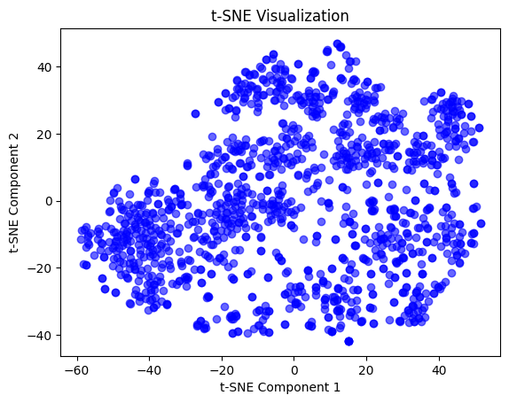
Active Learning Strategies
Density Sampling
Unlabelled Dataset

Slide 21
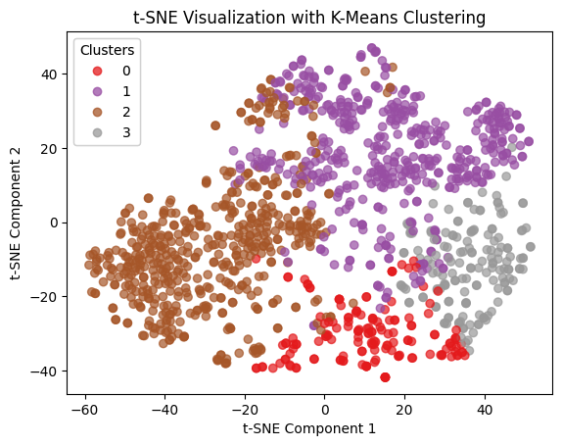
Active Learning Strategies
Density Sampling
Unlabelled Dataset

Slide 22
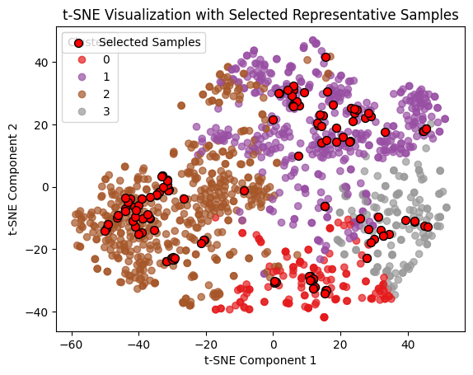
Active Learning Strategies
Density Sampling
Unlabelled Dataset

Slide 23
Active Learning Strategies
Density Sampling
Labelling
Labelled
Dataset
Train
Before: Validation Accuracy = 96.4%
Unlabelled
Dataset
After: Validation Accuracy = 98.8%

Slide 24
Active Learning Strategies
Density Sampling
Practical-2: Active Learning with Density Sampling
https://github.com/TQ-001/MPHY0050
- Lecture4/
- Practical_2_Active_Learning_DensitySampling.ipynb

Slide 25
Active Learning Strategies
Active
Learning
Uncertainty Sampling
Label data points where the current model is least certain
Density sampling
Label data points that are representative of many other points
Diversity sampling
Label data points that are least like already labeled points

Slide 26
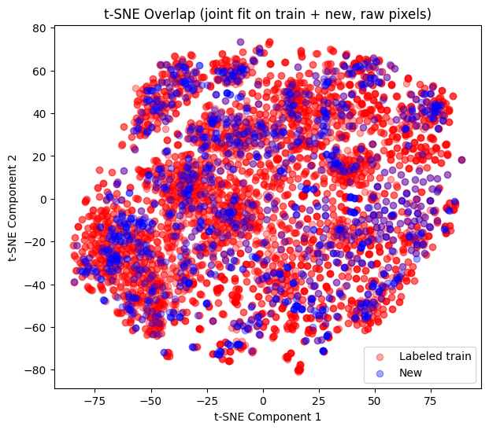
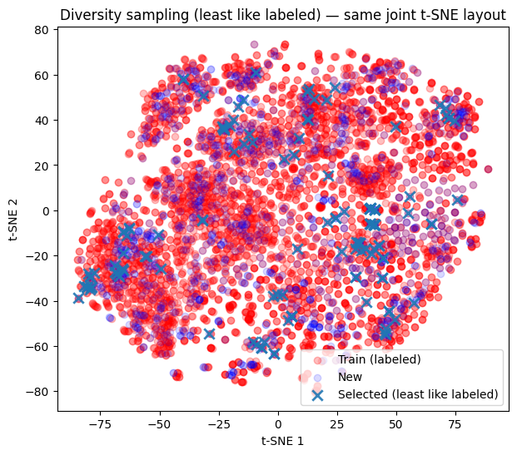
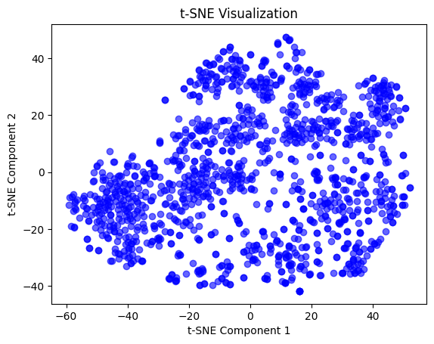
Active Learning Strategies
Diversity Sampling
Labelled
Dataset
Unlabelled
Dataset

Slide 27
Active Learning Strategies
Diversity Sampling
Labelling
Labelled
Dataset
Train
Before: Validation Accuracy = 96.4%
Unlabelled
Dataset

Slide 28
Active Learning Strategies
Diversity Sampling
Practical-3: Active Learning with Diversity Sampling
https://github.com/TQ-001/MPHY0050
- Lecture4/
- Practical_3_Active_Learning_DiversitySampling.ipynb

Slide 29
Active Learning Strategies
Active
Learning
Uncertainty Sampling
Label data points where the current model is least certain
Density sampling
Label data points that are representative of many other points
Diversity sampling
Label data points that are least like already labeled points

Slide 30
Active Learning Scenarios
The most common active learning methods can be categorized into:
● Stream-based Selective Sampling
● Pool-based Sampling
● Query Synthesis

Slide 31
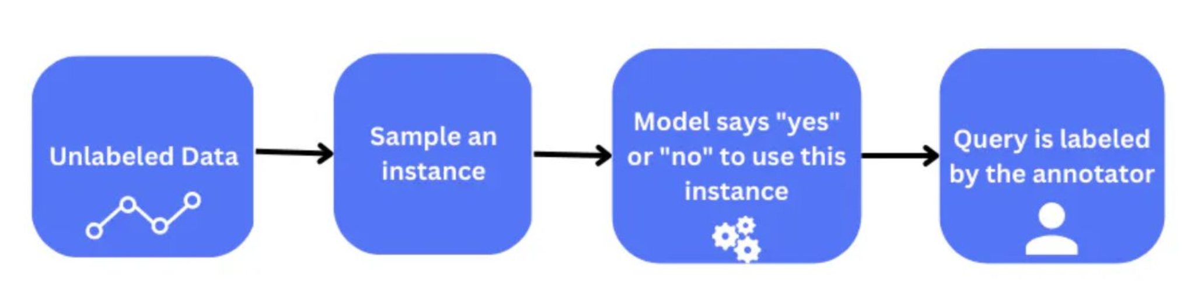
Active Learning Scenarios
Stream-based Selective Sampling
Data arrives in a streaming fashion, and decisions need to be made in real-time about which instances to label for model improvement

Slide 32
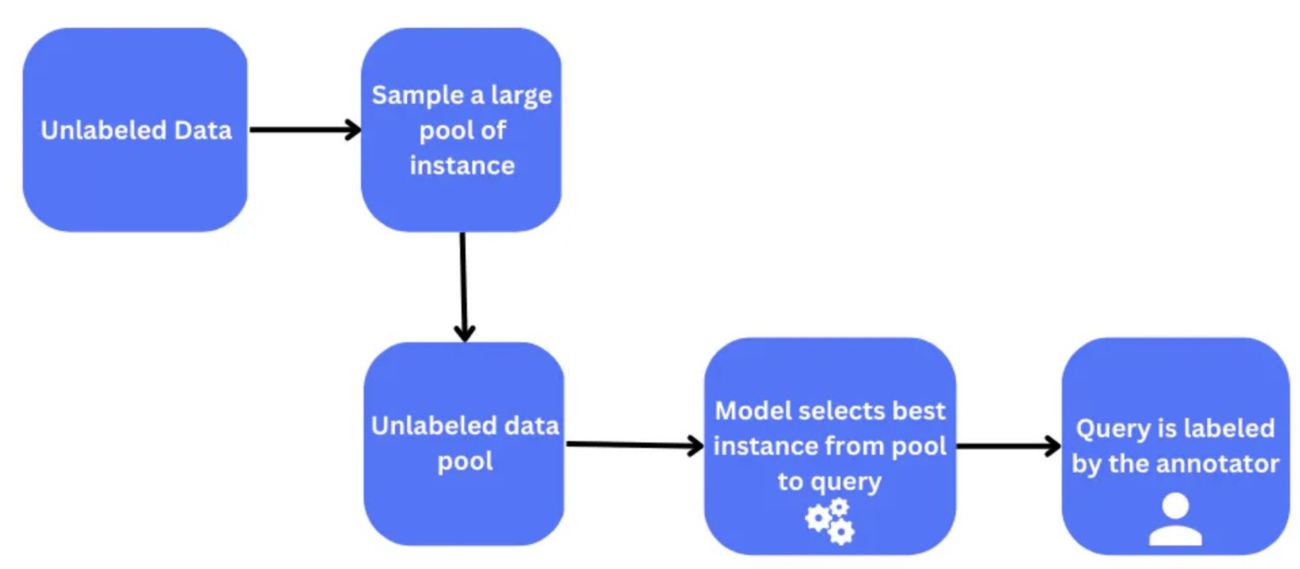
Active Learning Scenarios
Pool-based Sampling
A large pool of unlabeled data is available to draw samples from and the active
learning model seeks to select a batch of N samples from this unlabeled set

Slide 33
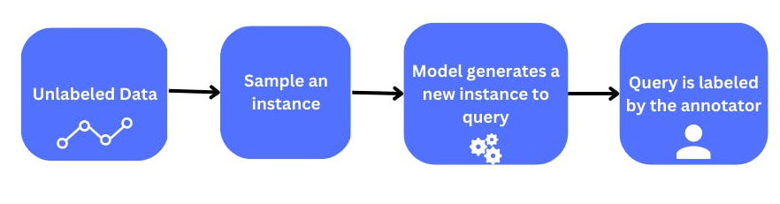
Active Learning Scenarios
Query Synthesis
Active learning agent is able to synthesis its own examples based on our training
examples for maximally effective learning

Slide 34
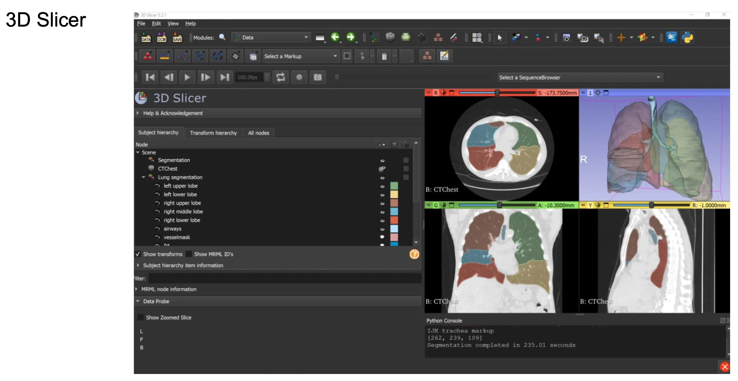
Active Learning Tools for Medical Tasks

Slide 35
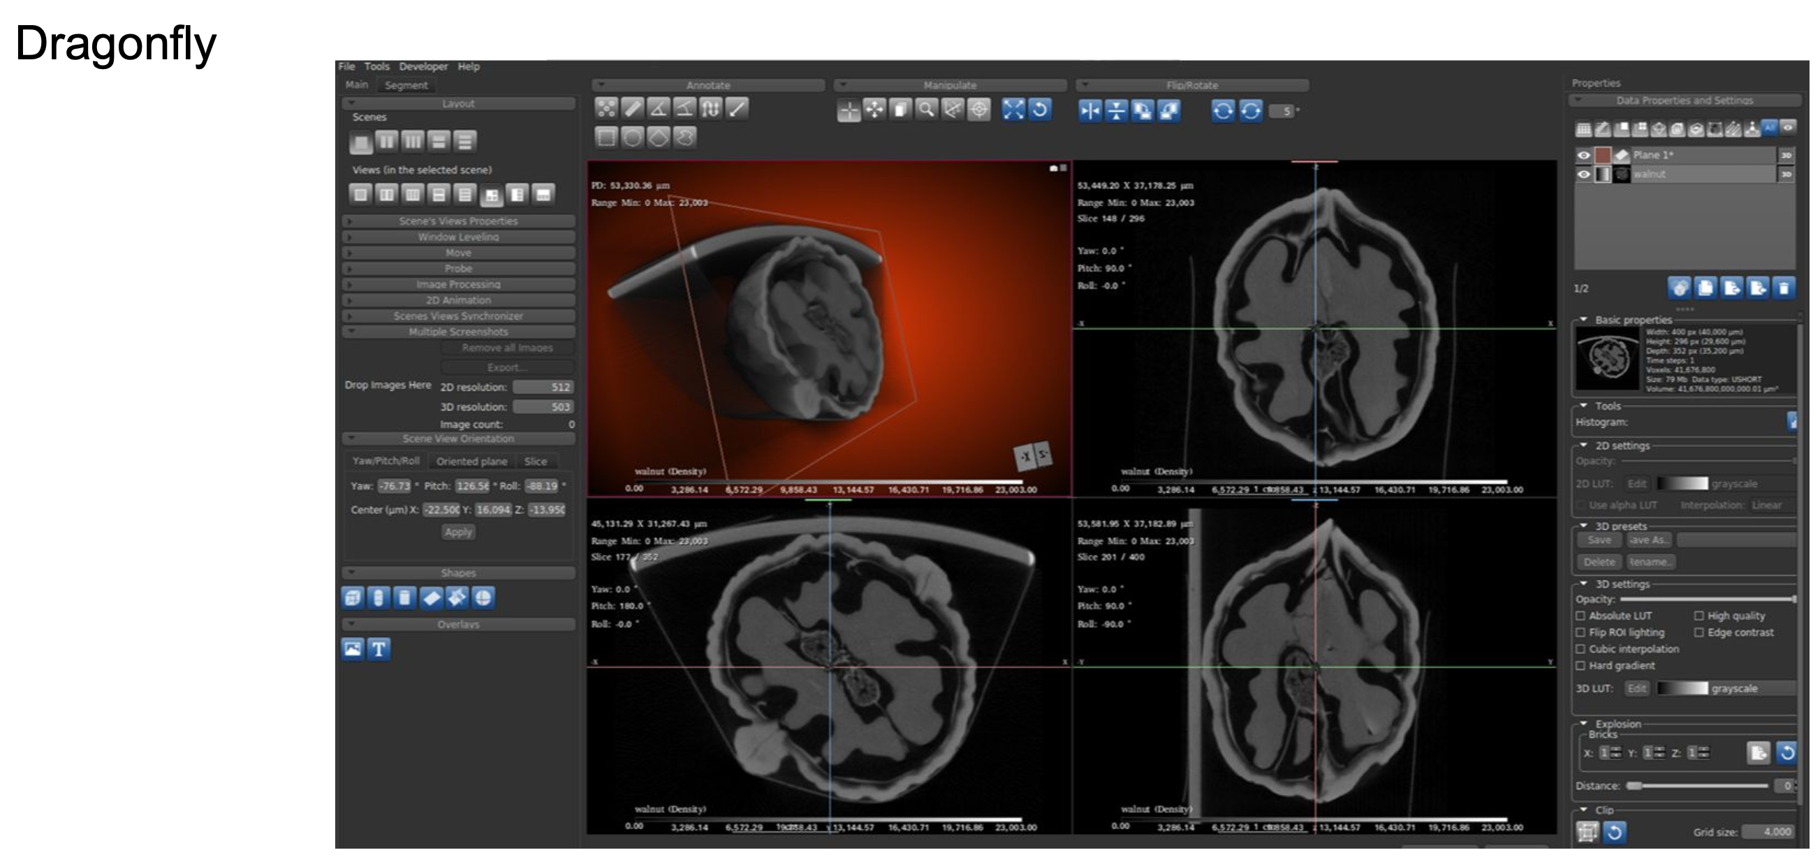
Active Learning Tools for Medical Tasks

Slide 36
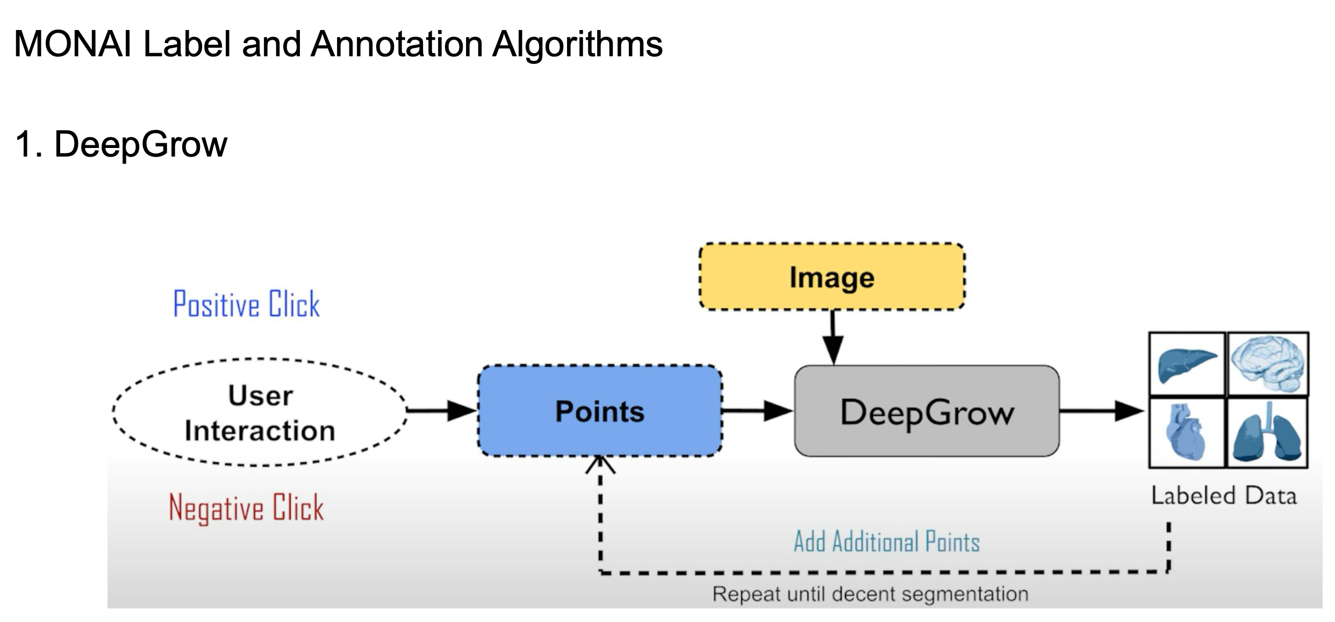
Active Learning Tools for Medical Tasks
(Interactive)

Slide 37
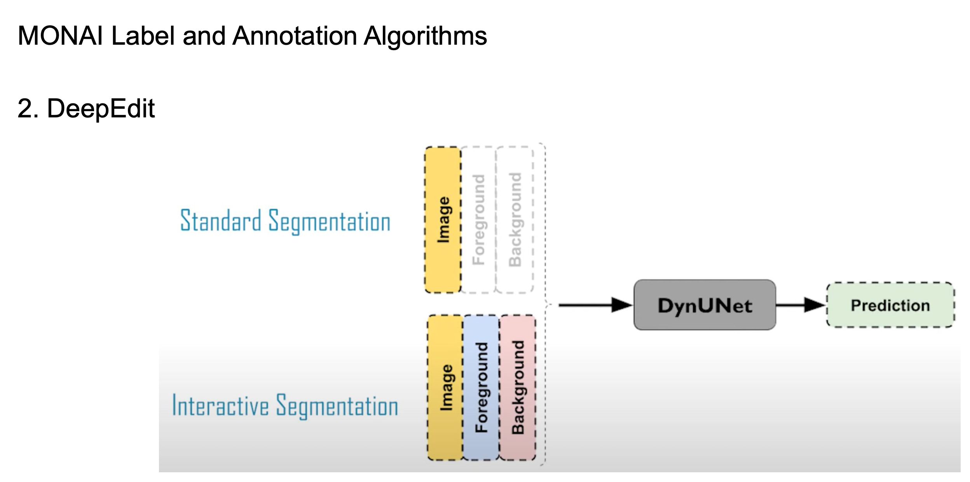
Active Learning Tools for Medical Tasks
(Interactive + Auto Segmentation)

Slide 38
Take Home
Weak supervision techniques help leverage imperfect or limited labels, enabling the development of robust models when high-quality annotated data is scarce.
Active learning allows models to intelligently select the most informative data samples for labeling, reducing annotation costs while maintaining high performance.
The best active learning strategy depends on the specific task and data characteristics
Uncertainty sampling is often the most effective when the goal is to quickly improve model performance with minimal labeled data
Density-based sampling is ideal for ensuring representative coverage of the data distribution
Diversity-based sampling helps in reducing bias and improving generalization across varied data instances.

Slide 39
Thank You!

